Slide 1
PROPERTIES DESIGN
Technical theatre

Slide 2
PROPERTIES DESIGN
Purpose of Properties Design:
Provides the audience with additional information about the character, local and economy especially when there is no set at all.
They are a vital part of the visual element.

Slide 3
ESSENTIAL QUESTIONS
What precautions are necessary to insure the safety of the performers?
How can props support the world of the play being created?

Slide 4
ELEMENTS OF DESIGN
LINE
Angled, jagged, straight, curved or combination?
SHAPE
outlines or silhouettes?
any reoccurring objects?
TEXTURE
smooth=orderly, finished, sleek, elite,
rough=harsher, chaotic, poor, earthy,
MASS
spatial arrangement of the stage
Chaotic, spacious or varied?
heavy or light?
COLOR
Any reoccurring colors?
Do colors contradict or compliment the overall feeling or mood of the script?

Slide 5
PRINCIPLES OF COMPOSITION
UNITY
What is it that connects the show together?
theme, color, feeling, shape? character? An idea?
HARMONY
Harmonious vs inharmonious?
CONTRAST
contradict your visual theme
VARIATION
varying any of the design elements of a given pattern
BALANCE / PROPORTION
symmetrical vs asymmetrical?
EMPHASIS
direct the audience’s attention - giving accent to : a part of a the stage, costume, actor,

Slide 6
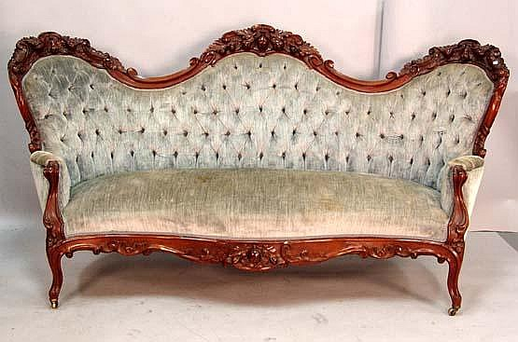
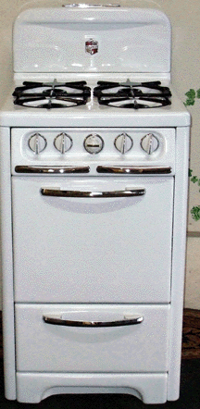
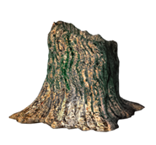
SCENIC (set) PROPS
Larger, moveable items, not built into the set, in which the actors use.
Furniture
Lamps
Rugs
Stoves
Tree stumps
Swings

Slide 7
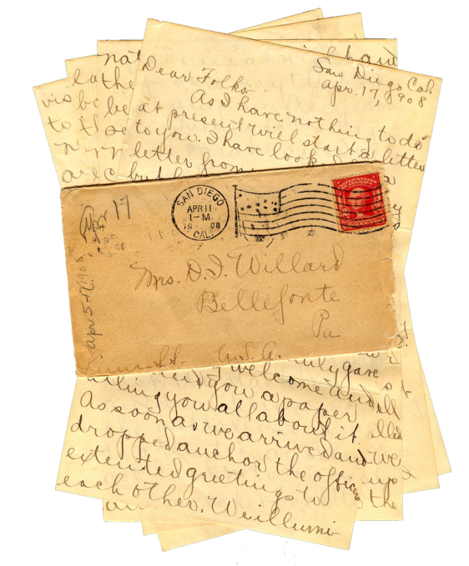
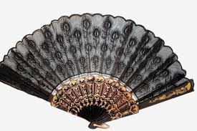
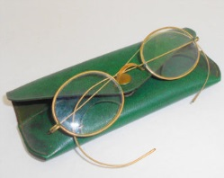
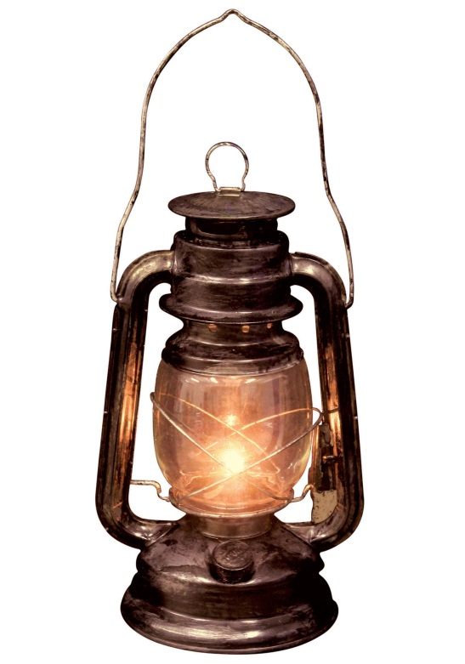
HAND (personal) PROPS
Smaller items that the actors carry, sometimes to help develop character.
Letters
Books
Fans
Lantern
Eye Glasses
Pipe
News paper
Cane
Knitting
Wine Glass

Slide 8
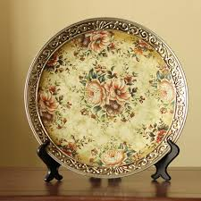
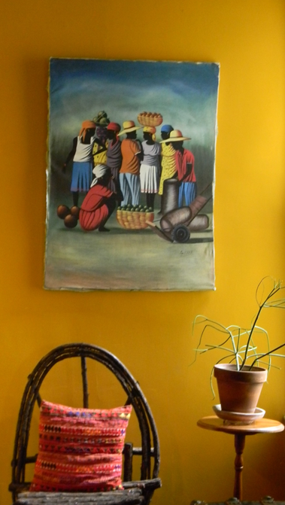
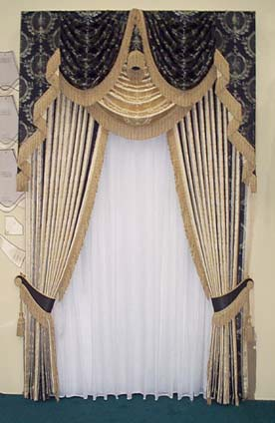
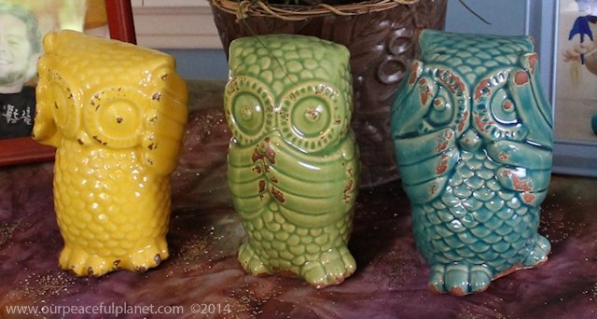
DECORATIVE PROPS “set dressings”
Anything used to enhance the setting visually, but not specifically touched by the actors. It give the room “character”
Curtains
Pictures
Knick-knacks
Plants

Slide 9
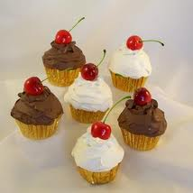
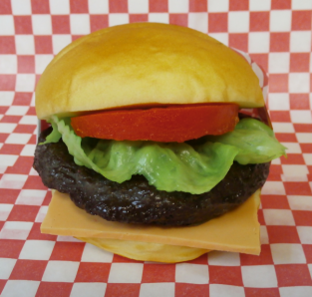
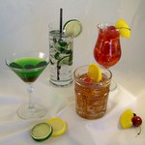
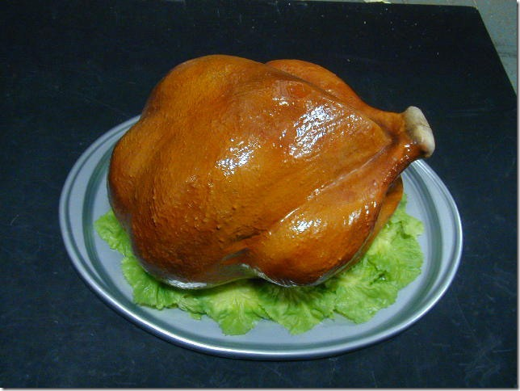
PERISHABLE PROPS
any prop that needs replacing
once it has been used
Food
Drinks
Torn up letter
Pool of water
ALCOHOL
Alcoholic beverages, should NEVER be used on stage.
Bottles are emptied and filled with water then food coloring added, or filled with tea.
Soda ☹ carbonation
National Theatre-PROP FOOD http://youtu.be/Yjv63vDveFk

Slide 10
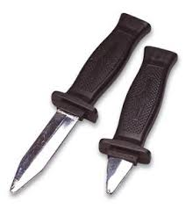
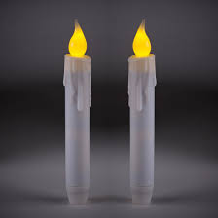
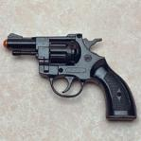
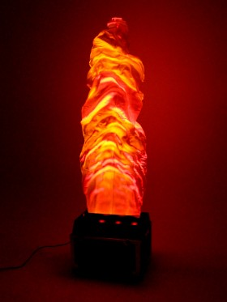
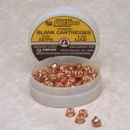
SPECIAL EFFECT PROPS
WICKED: Special Effects
http://youtu.be/SGeP5xH1Gtw

Slide 11
ACQUIRING PROPS
Pull
pull props from the theatre's prop storage
Borrow
an individual in the community
a business
(especially a furniture store or antique shop)
another theatre company
Rent
from a commercial prop studio
Repertory Theater St. Louis
Opera Theatre St. Louis
Stages St. Louis
Buy
usually from a 2nd-hand store
Good Will
Build
in the scene shop

Slide 12
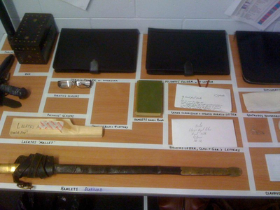
PROP TABLE
Hand props are stored between onstage & off stage use
Props are taped out with masking tape and labeled with prop name & character name to assure their accountability
Secure, in a lockable cabinet, all hand props each night. This is especially important if valuable antiques or lethal weapons (such as a gun, knife or sword for example) are used.

Slide 13
PROP WARNINGS
Don't play with the props.
Don't sit on the furniture.
Don't touch some one else's prop.
If it's not yours, leave it alone.
Put your prop back on the table when you're done.
If it's not a prop, don't put it on the prop table

Slide 14
PROPERTIES PRODUCTION
PROPERTIES DESIGNER
Prop Research
Prop Notes
Prop Plot
Prop Sketches (if needed)
Prop Designs (if needed)
PROPERTIES CREW
Pull, borrow, build, rent props as needed
Organize props
Assist backstage with props
National Theatre-PROP DEPT. http://youtu.be/WNESPJthc6o
Nat Thtr –CREATING GRAPHICAL PROPS http://youtu.be/yQ33KFg5S-g
National Theatre-SOFT PROPS http://youtu.be/HAvnnZ4PuO4
WAR HORSE PUPPETRY & PROPS
http://youtu.be/6DEOYsM_-OI

Slide 15
PROPERTIES DESIGN PROJECT
PROPERTIES DESIGN PRODUCTION
Props Research
Props Notes
PROPERTIES DESIGN APPLICATION
Choose a prop from your show to build or reconstruct.
Include research, sketch and scale drawing.

Slide 16
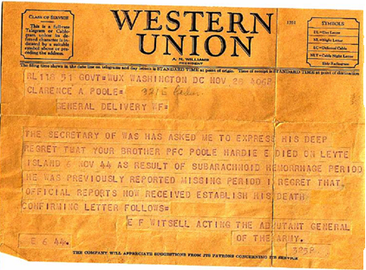
PROP RESEARCH

Slide 17
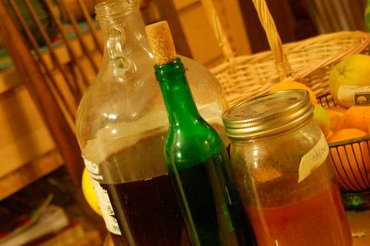
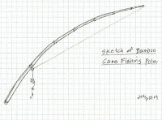
PROP RESEARCH
HOOTCH
A poorly designed alcoholic beverage made with pitiful equipment & inappropriate ingredients. Always homemade.
How to Make Fishing Pole from Cane Bamboo:
Find or buy Bamboo Poles
Cut your canes to the size you need.
Dry and cure Poles
Tie rope lines to poles
Add cork float, sinkers and hook

Slide 18
PROPERTIES NOTES
Record any PROP that a character uses, talks about on the set but may not use, or is mentioned as part of the set.
These are the “have to’s” the musts!
ACT | PG | PROP | CHAR | HAND | SET | DEC | NOTES
1 | 1 | Kitchen table | -- |  | X
1 | 1 | couch | -- |  | X |  | 1960’s
1 | 1 | Coat rack | -- |  | X
1 | 10 | Vase | -- | X |  |  | Plastic – gets throan
1 | 15 | Telephone | -- | X |  |  | rotary
1 | 21 | Purse | Suisie | X
1 | 27 | Blind stick | Suisie | X
1 | 29 | Money | Suisie | X |  |  | Preset in purse $3
1 | 32 | Photo equip | Sam | X | X |  | Must work
1 | 41 | Doll | Gloria | X |  |  | Open in back drugs; plays music
1 | 42 | pantry | Gloria |  | X |  | She hides inside

Slide 19
PROPERTIES PLOT
The plot is a way to track a character’s use of props from the beginning of a show to the end
Now is where you should be more creative, add more detail & personal props. Ask for actor input!
PROP | ACT | PG | PROP | LOC | REH | FNL | PER | CHAR | NOTES
1 | 1 | 9 | divining rod | Off L |  | X |  | Buddy
2 | 1 | 12 | post hole digger | Off R |  | X |  | Melvin
3 | 1 | 12 | shovel | PS hole |  | X |  | Melvin
4 | 1 | 14 | suitcases | Off L | X |  |  | CC Showers | weight down
5 | 1 | 15 | broom | Off R |  | X |  | Goldie
6 | 1 | 21 | plug | Ferris | X |  |  | Ferris | big chew gum
7 | 1 | 27 | mop | Off L | X |  |  | Norma
8 | 1 | 29 | rootbeer | Off L |  | X |  | Buddy
9 | 1 | 29 | coffee | Off L |  | X | X | Goldie | full
10 | 1 | 30 | donut | Off L | X |  | X | Goldie
11 | 1 | 30 | sign | Off L | X |  |  | Goldie | set built

Slide 20
PROPS PLOT
This props plot tracks the location of the prop very specifically

Slide 21
Brighton Beach Memoirs

Slide 22
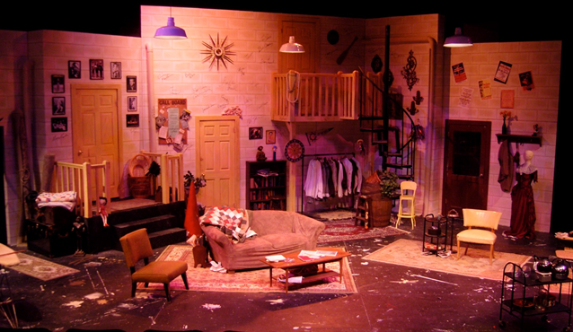
Moon Over Buffalo

